Slide 1

Automating AWS Infrastructure with IaC
Presented by Jay Patel | Student Number: 9062044

Slide 2




Project Overview: AWS Infrastructure Deployment with CDK (Python) / Terraform
Goal
Key Tools
Automate AWS infrastructure creation using Infrastructure as Code (IaC) for efficiency and consistency.
Leveraged AWS CDK (Python) for defining infrastructure, CloudFormation for provisioning, and AWS CodeBuild for CI/CD.
Optional Exploration
Also explored Terraform as an alternative IaC solution for comparison and broader understanding.

Slide 3
Infrastructure Deployed with AWS CDK / Terraform
Using AWS CDK, we provisioned a foundational AWS environment, encapsulating best practices and scalability.
1
2
Virtual Private Cloud (VPC)
Public Subnet
A logically isolated section of the AWS Cloud where resources are launched.
A subnet directly accessible from the internet, hosting public-facing resources.
3
4
Routing Configuration
EC2 Instance
Configured Internet Gateway and Route Tables for seamless network traffic flow.
A scalable virtual server to host applications within the VPC.
5
6
Security Group
Optional: RDS Instance
Configured for secure SSH access, acting as a virtual firewall for the EC2 instance.
Provisioned a managed relational database service for persistent data storage.
All these resources are automatically generated and managed through AWS CloudFormation, ensuring consistency and repeatability.

Slide 4
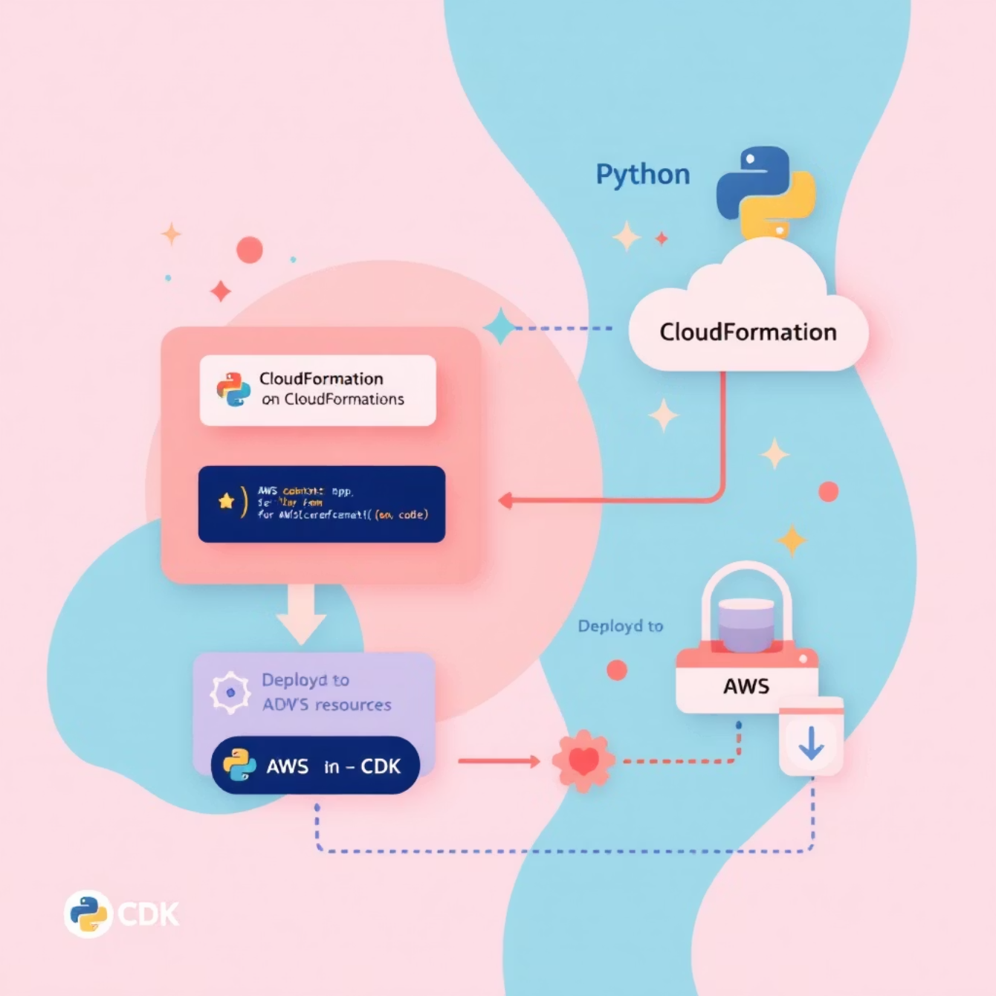
Project Folder Structure: AWS CDK Implementation
app.py
Key Idea: Code to Cloud
The entry point for the AWS CDK application, orchestrating the infrastructure stack definition.
We write infrastructure definitions in Python code, which AWS CDK then synthesizes into CloudFormation templates. CloudFormation subsequently deploys these templates as actual AWS resources.
cdk/InfraStack.py
Contains the Python code defining all the AWS resources and their configurations.
requirements.txt
Lists all necessary Python dependencies for the CDK project.
buildspec.yml
AWS CodeBuild specification file for automated build and deployment processes.
cdk.out/
Directory containing the CloudFormation templates generated by CDK.

Slide 5







Deployment Workflow: Streamlining with CDK and CodeBuild
Local Development Workflow
CI/CD Workflow with buildspec.yml
1. Install Dependencies
1. Install Requirements
Set up the local environment by installing all required Python packages.
CodeBuild automatically installs project dependencies.
2. Synthesize Templates
2. Synthesize Template
Run cdk synth to generate CloudFormation templates from the CDK code.
CDK synthesizes CloudFormation templates within the build environment.
3. Automatic Deployment
3. Deploy Resources
The infrastructure is automatically deployed to AWS, removing manual intervention.
Execute cdk deploy to provision the defined AWS infrastructure.
This automated approach significantly reduces human error and accelerates deployment cycles.

Slide 6
Project Folder Structure: Terraform Implementation
1
main.tf
Core Terraform configuration defining critical AWS resources like VPC, EC2, RDS, and S3 buckets.
2
variables.tf
Defines input variables for customizable parameters such as AMI IDs, instance types, and database names.
3
terraform.tfvars
Contains the actual values for defined variables, kept private for security.
4
provider.tf
Configures the AWS provider and specifies the target region for deployments.
5
backend.tf
Defines the backend configuration for storing Terraform state, either remotely or locally.
6
modules/
Directory for reusable Terraform modules, promoting modularity (e.g., VPC, EC2, RDS, S3).
7
.terraform/
Local directory for provider binaries and cached modules.
8
terraform.tfstate
Crucial file storing the real-time state of all provisioned AWS resources.

Slide 7
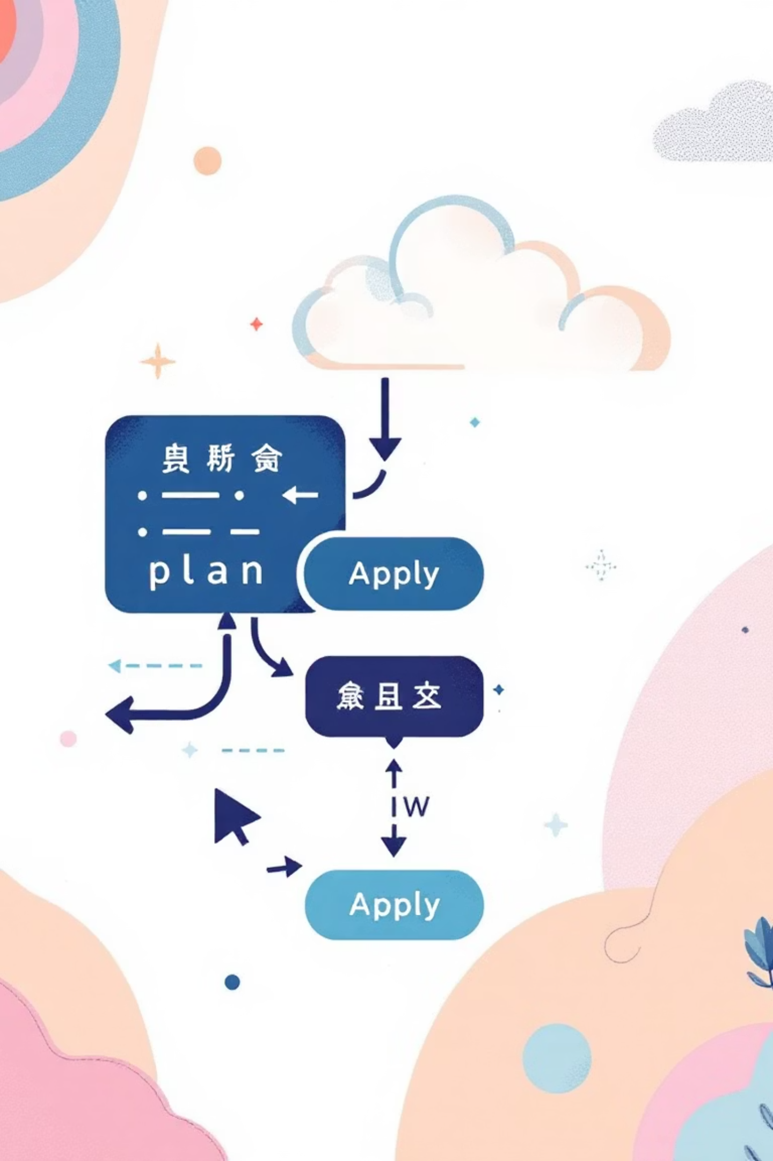
Terraform's Core Principle: Declarative Infrastructure
Key Idea:
We define our desired AWS infrastructure in declarative .tf files. Terraform then intelligently plans the necessary changes and applies them to match the specified configuration, ensuring the infrastructure's state aligns with the code.

Slide 8


Deployment Workflow: Managing Infrastructure with Terraform
Local Workflow
Terraform State Management
01
Terraform utilizes the terraform.tfstate file to track all created resources.
1. terraform init
Idempotent Deployments
Downloads providers, initializes the backend, and configures the environment for operation.
Ensures that applying the same configuration multiple times yields the same result without unintended side effects.
02
2. terraform plan
Prevents Duplication
Generates an execution plan, showing exactly what changes will be made before applying changes.
Avoids creating duplicate resources by knowing the current state of the infrastructure.
03
Facilitates Updates
3. terraform apply
Allows for efficient updates without requiring resource recreation.
Provisions all AWS resources precisely as described in the .tf files.
Safe Rollbacks
04
Enables controlled rollbacks to previous infrastructure states.
4. terraform destroy
Safely removes all infrastructure when no longer required.
Optional CI/CD Integration
In a CI/CD pipeline, Terraform steps include fmt, validate, plan (with optional approval), and apply for fully automated provisioning.

Slide 9

Results & Key Learnings from IaC Deployment
Achieved Milestones
Valuable Insights Gained
Fully Automated Infrastructure
CDK Bootstrap Requirement
Successfully provisioned complex AWS infrastructure with zero manual steps.
Understood the necessity of CDK bootstrapping for deploying resources to an AWS environment.
Reusable & Version-Controlled IaC
CloudFormation as Core Engine
Infrastructure definitions are now codified, shareable, and trackable, enabling collaboration and change management.
Recognized CloudFormation as the underlying deployment engine for CDK, validating resource creation.
Clean CloudFormation Deployment
buildspec.yml for Automation
Leveraged CDK to generate well-structured CloudFormation templates, simplifying AWS resource management.
Mastered the use of buildspec.yml to achieve end-to-end automation in CI/CD pipelines.
IaC Benefits
Confirmed that IaC significantly reduces human error, increases deployment speed, and enhances system reliability.

